Slide 1

Applied Fiction Redux for those of you who missed our last episode…
MetaMythic | Nerc HPC 2015
Notes:
Copyright MetaMythic, LLC. You are free to distribute this presentation in this form or in similar form with the following condition:
If you wish to alter or use content from this presentation to promote these ideas, we would love for you to share the information. Just make sure 1.) you give MetaMythic credit, 2.) link to our website wherever you publish or publicize this information and 3.) let us know how you’re using the content before you use it. An email notification is fine.

Slide 2


Share the Good News
#AppliedFiction #NercHPC @chrislazzaro
Notes:
Tweet if you like what you’re hearing

Slide 3
Our First Fiction
For sale:
baby shoes
, never worn
-Ernest Hemingway
Notes:
Many of you know Arthur C. Clark, the great science fiction writer who recently passed away. In a letter he recounts a conversation with Ernest Hemingway and some others authors at a table over lunch. The story goes that Ernest bet the table $10 each that he could tell a story in just six words. Do you think he won the bet? <pause>
Here's what he came up with.
<click>for sale <pause>
<click>baby shoes <pause>
<click>
Do you feel any emotion after reading this last portion? Are you thinking of what the rest of the story might be? Is it a sorrowful story, one of loss? Is that something you resonate with yourself or through knowing someone who has lost a child or gone through infertility? Maybe it's a humorous story? Ever had your kids outgrow their clothes before they have even worn them once?
So you can tell a story even in a very short space.

Slide 4
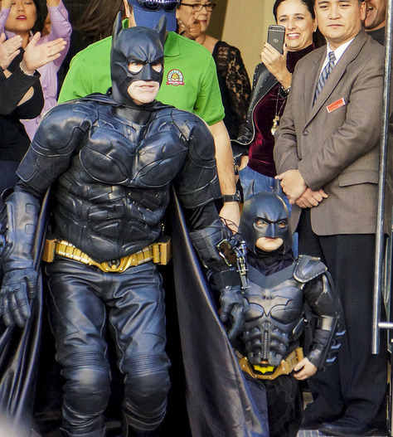
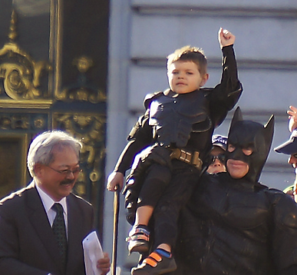
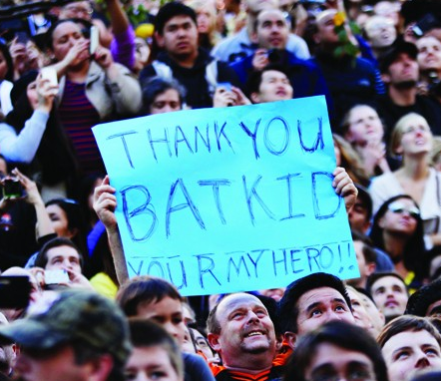
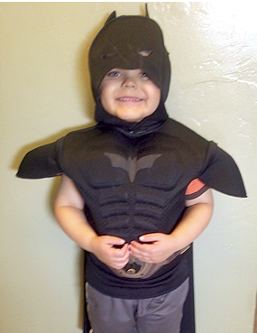
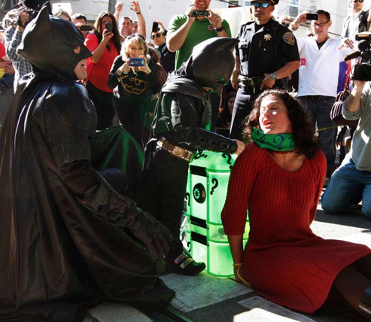
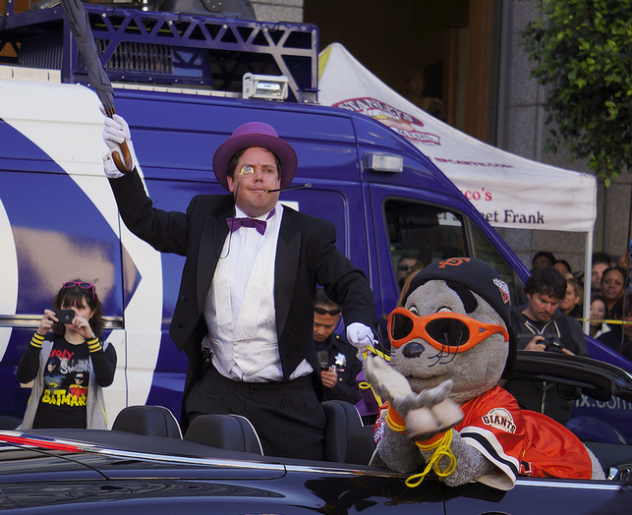
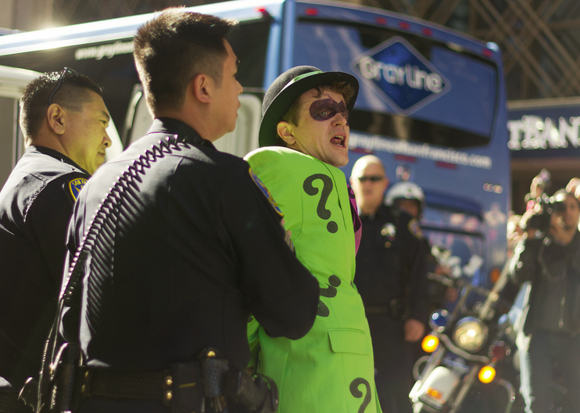
or
First, A Case Study
You battled cancer and all the pain, uncertainty and fear that comes with that battle.
That makes you a Hero.
Notes:
Batkid – Laughing Squid
https://www.flickr.com/photos/32159045@N02/11397861526/
https://creativecommons.org/licenses/by-nd/2.0/
Batkid and Batman – Shelley Provost
https://www.flickr.com/photos/photogism/10888722333/in/set-72157637732324446
https://creativecommons.org/licenses/by/2.0/
Damsel
http://www.polygon.com/2013/12/14/5208764/batman-eric-johnston-batkid-make-a-wish-san-francisco
Riddler – Bhautik Joshi
https://www.flickr.com/photos/captin_nod/10880516574
https://creativecommons.org/licenses/by-nc-sa/2.0/
Penguin – Shelley Provost
https://www.flickr.com/photos/photogism/10888719643
https://creativecommons.org/licenses/by/2.0/
BatKid and Batman and SF Mayer – Shelley Provost
https://www.flickr.com/photos/photogism/10888436386/in/set-72157637732324446
https://creativecommons.org/licenses/by/2.0/
How many of you are from San Francisco? <wait for hands to raise> That's great. Does anyone here know who Miles Scott is? (if some says yes, ask them who he is. If not, ask this next question:) Does anyone here know who BatKid is?
<click> BatKid is San Francisco's local superhero. Did you know you have a superhero here in town? Let me tell you about one of his recent adventures.
One day in 2013, Miles was in his hotel room and saw on the television set a call for BatKid's help from the chief of police.
<click> After suiting up, Batman picked him up in the batmobile and they headed to the scene of the crime. You can see the innocent bystanders in the background here.
<click> It was a good thing they arrived in time because a damsel in distress was tied to a bomb. They saved the day. But then they found that the Riddler was robbing a bank
<click> So they took care of him. Then the penguin drove by with the Giant's mascot Lou Seal in his clutches. They followed him to the stadium where in front of thousands Batkid and Batman saved the mascot and the day.
<click> At the end of this mass criminal activity, Batkid was presented with the key to the city by the mayor and celebrated his success with his fans.
So was this just a fun story?
<click> The real story is that Miles Scott was diagnosed with leukemia when he was 18 months old and went through three years of chemotherapy. Has anyone been through chemo or known someone who has? <wait for hands>
My aunt and grandmother both went through chemo for breast cancer and I remember what they looked like and the stories they told of throwing up and the misery of putting toxic chemicals in your body. They are adults, this kid started treatment before he could form sentences.
He has just finished his last round of chemotherapy and the Make a Wish foundation used this event to make his wish to be BatKid come true. Over 1.5 billion people have viewed information about this story. Half a million tweets were make that day. They expected a few hundred volunteers and they estimate that 12,000 people showed up.
So why did people do this for Miles? Was this fun and entertaining for him? Was this a nice reward for him? Yes and yes, but I think if we stop there we miss something important. I think this community wanted Miles to learn something. I think they wanted him to learn an important truth in order to change his perspective on himself.
I think that truth was that <click> this young boy's courage facing these issues that no kid should face makes him a hero. I think this community wanted him to know this truth.
But the question is why this story? This was expensive and time consuming. Why couldn't they just write him a letter and say these words? That's cheaper and conveys the same message, right? Somehow 12,000 people didn't think that was enough. They wanted to apply fiction to this truth to make it more memorable and engaging.
Is there something we can learn from this?

Slide 5
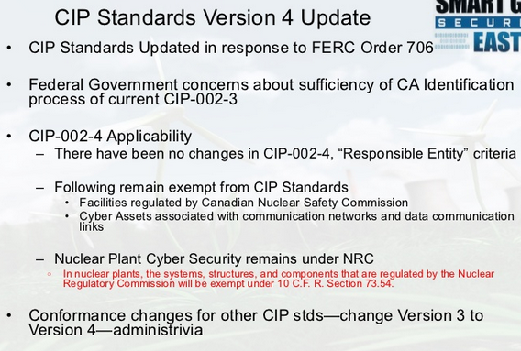

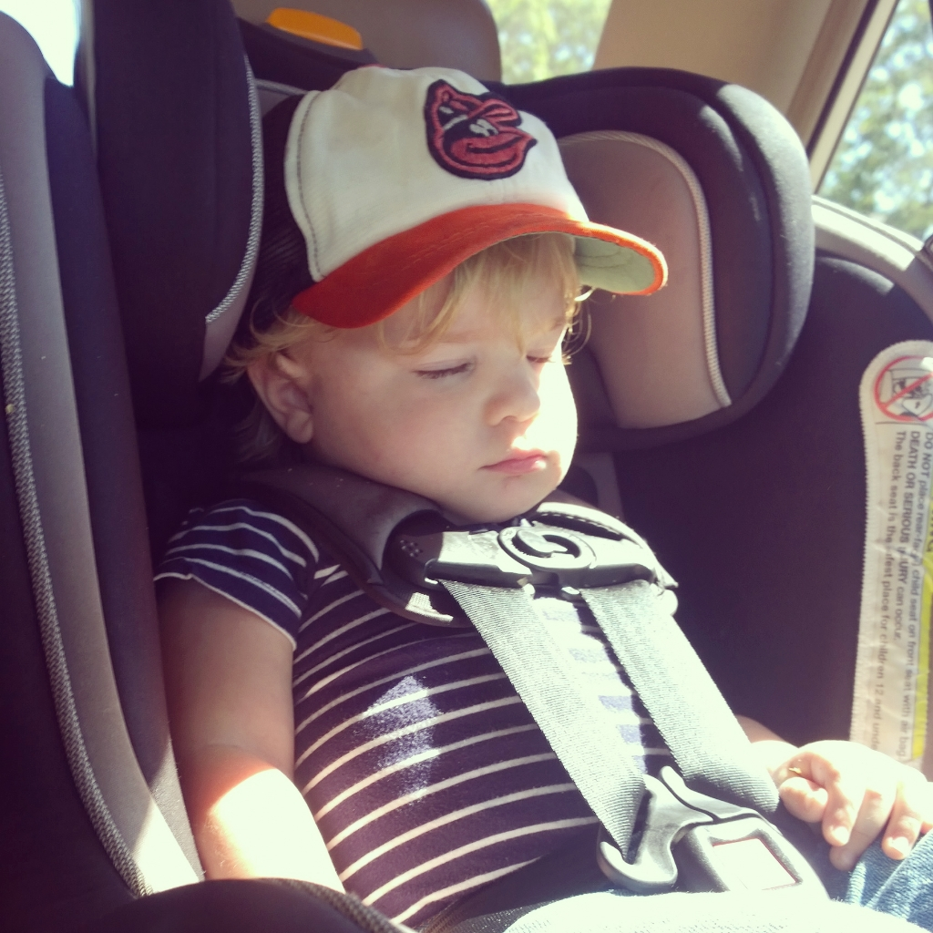
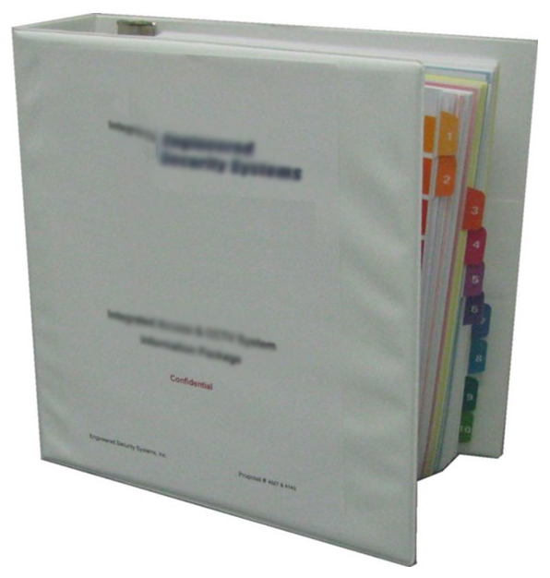
Businesses Solve this Problem … Differently
Notes:
So what do we do in business? Our companies expect us as HP professionals and trainers to use the same tired techniques of PowerPoints <click> and manuals <click> inside companies. Facts upon facts. Well, besides personal experience sitting through a myriad of boring executive leadership events and training, I hear examples all the time.
And we do it with products as well. What do you think this 104 page manual is from. It’s for this little guy <show picture of Atticus>. This is the manual for his car seat. It takes 104 pages to teach me how to setup his car sear properly.

Slide 6


Applied Fiction
Teaching important truths by adding fiction to improve engagement, understanding and retention.
Notes:
In order to grow, we need to learn new truths and that's hard. It's hard because learning truth is uncomfortable, but also because we have trouble understanding, engaging and remembering. Stories are a great tool for doing this, but organizations and people aren't always good at telling them and many times, the true stories are missing components that make them engaging, understandable and memorable.
By applying fiction to true stories, we can fill those gaps and help communities grow. We can solve real business problems. We call this Applied Fiction.

Slide 7
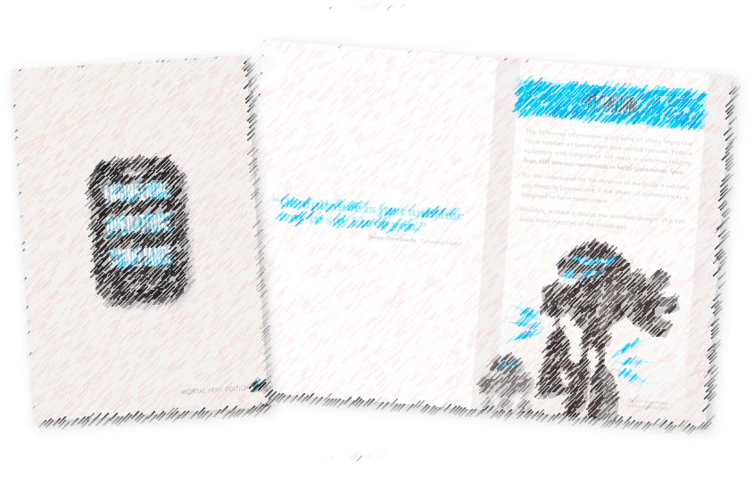
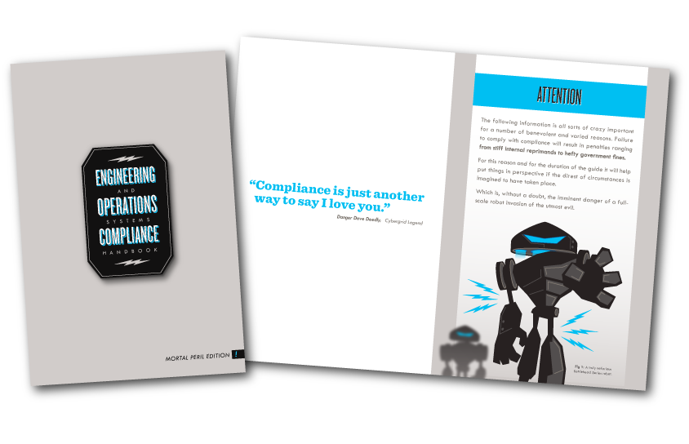
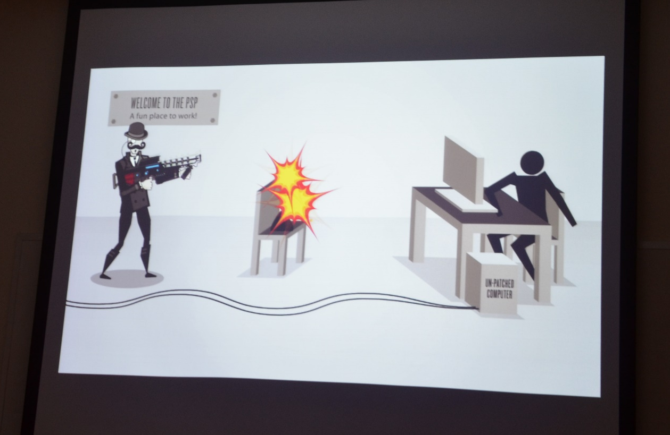
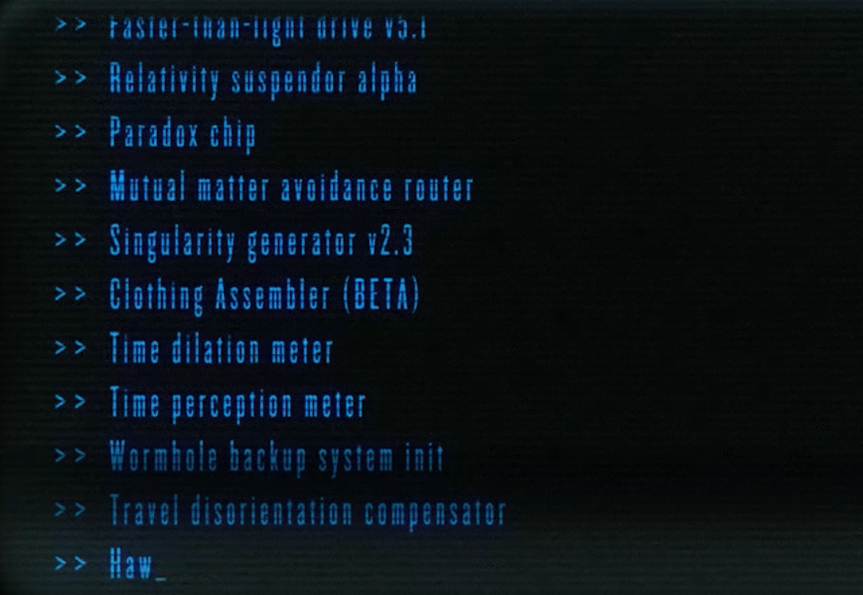
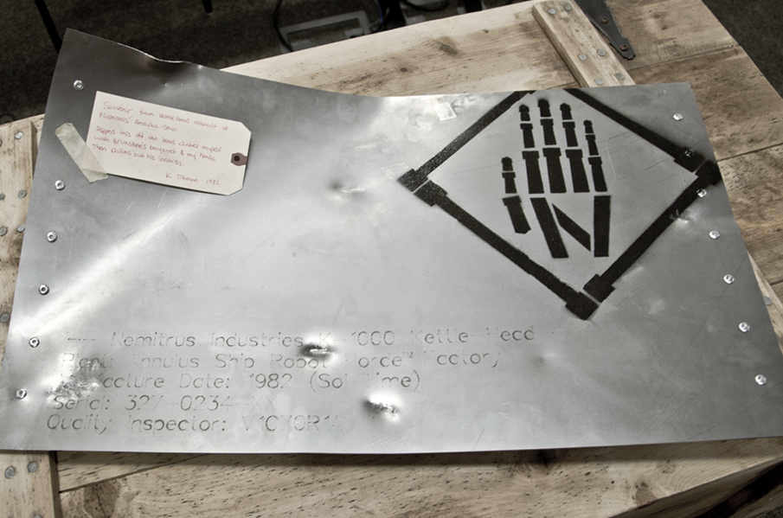
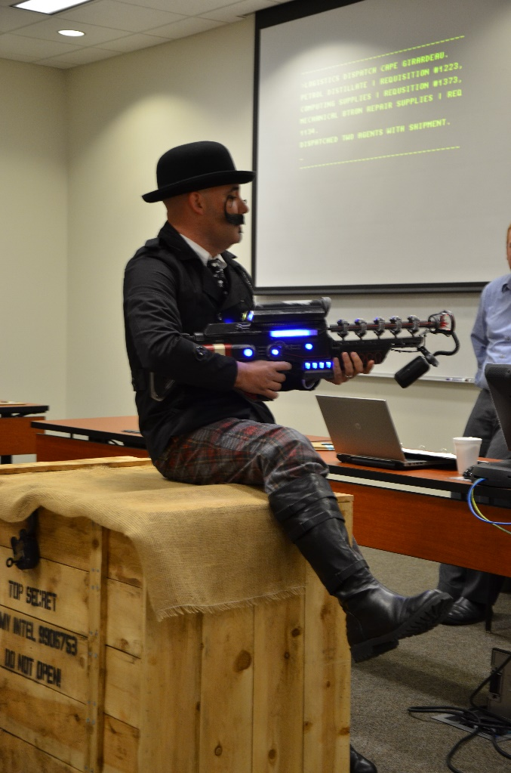
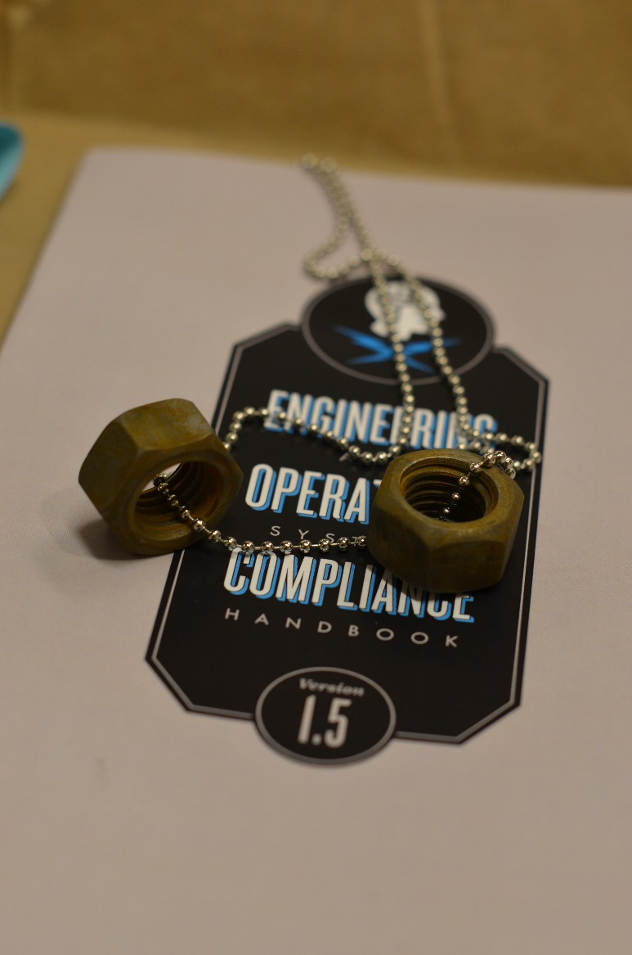
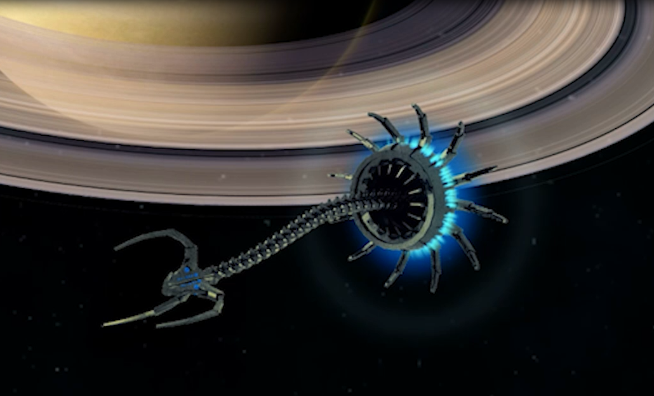
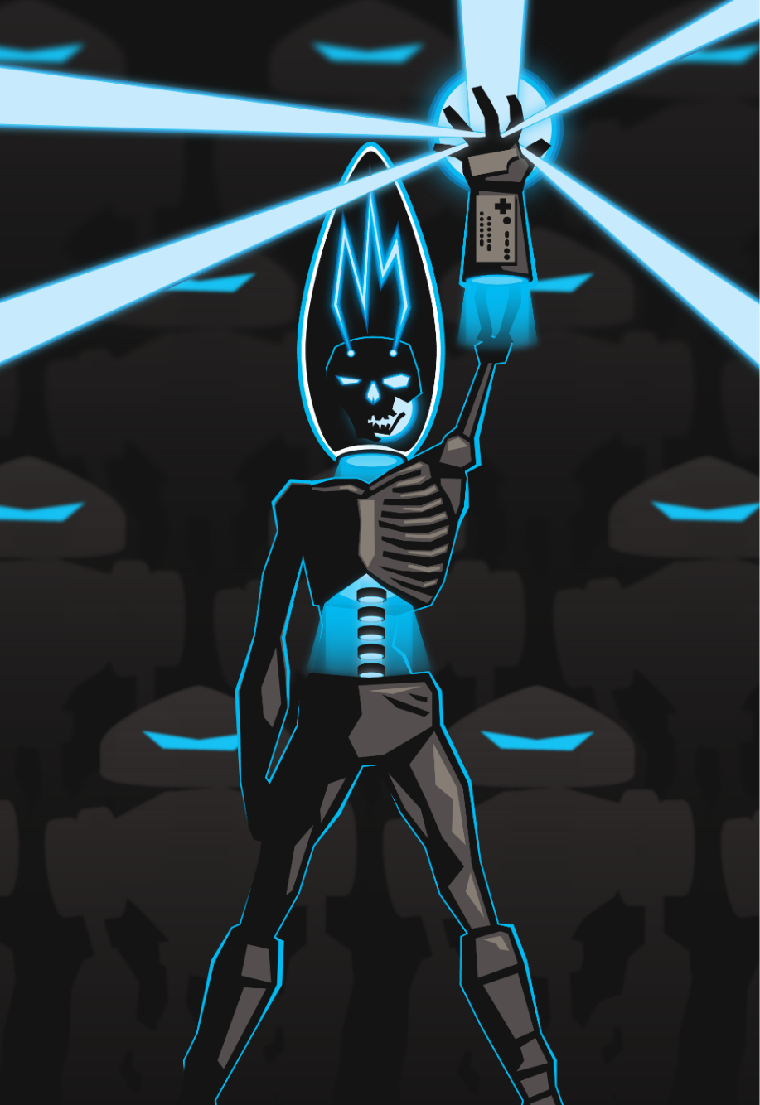
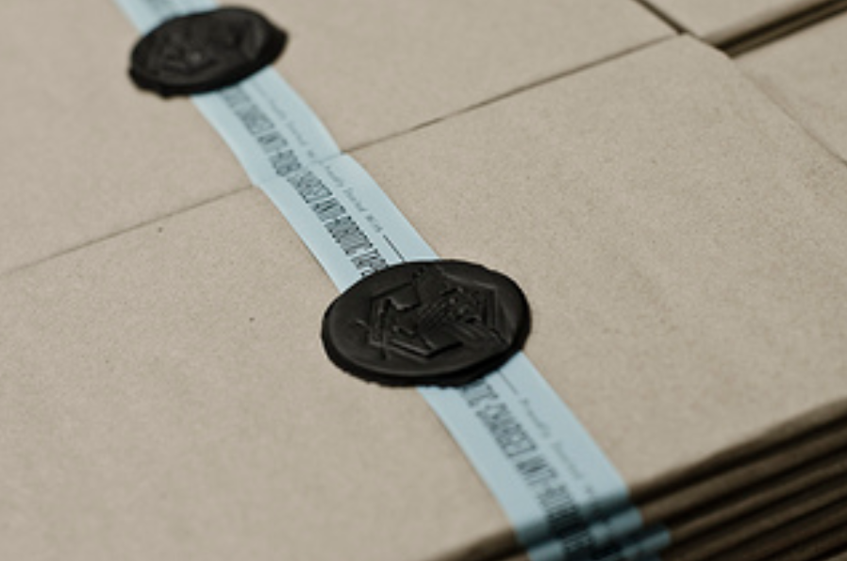
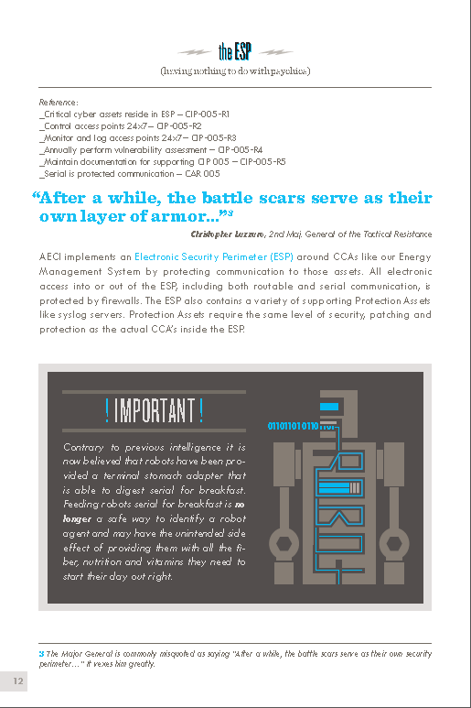
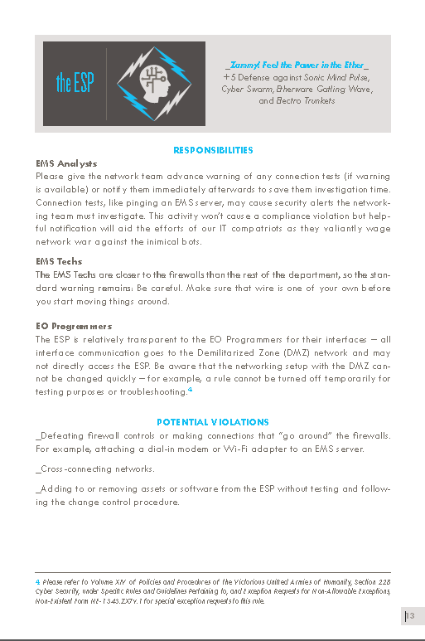
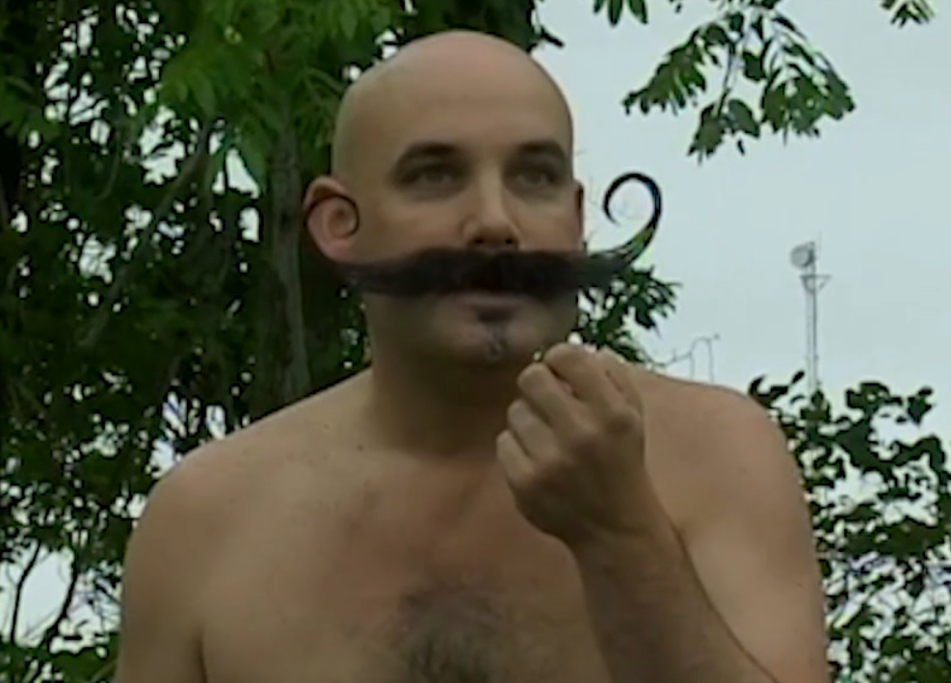
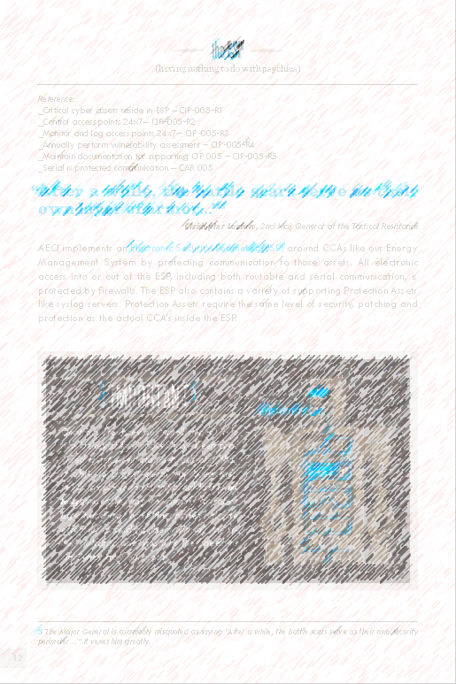
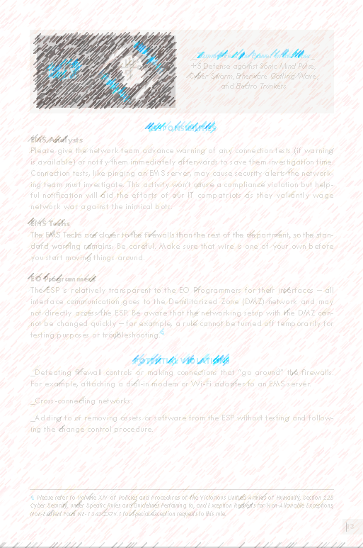
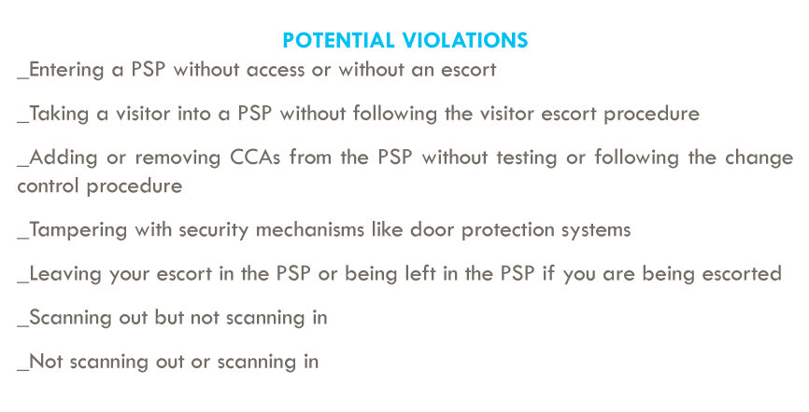
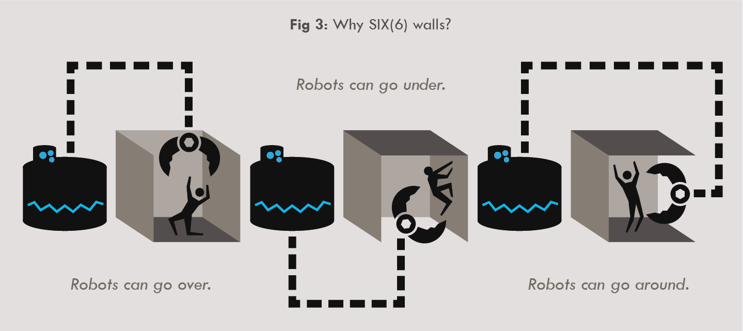
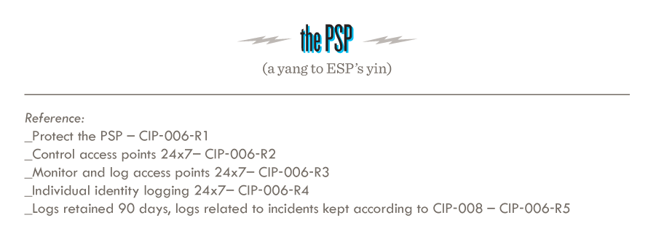
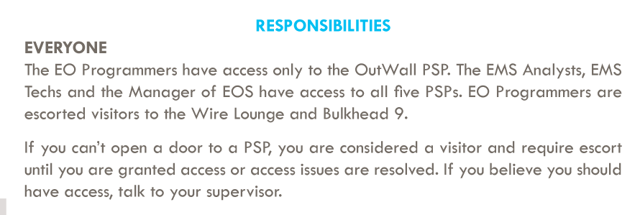
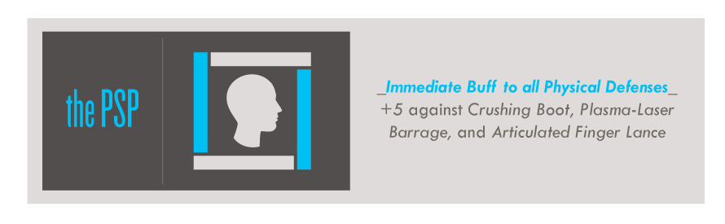
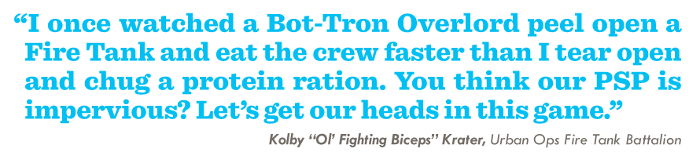
Earth depends on us.
CIP Compliance Case Study
It's essential for us to sustain compliance or else we might be hacked, get big fines or lose our independence.
Compliance is our best weapon.
or
And we are all
compliance heroes.
Notes:
Let me share a company who did this differently with Applied Fiction. Their truth was this:<click>
Compliance. In the energy industry compliance is all about keeping the grid secure because if you don't you might get some hefty fines, lose your independence or (the main reason) get hacked. If you work in an industry that has compliance you know how dreadful it is. The painful training classes, the boring lists of things you can or can't do.
So when employees filed into a training room one day for a meeting on the calendar with no title and no agenda, they understandably dropped their heads to the table once the meeting was introduced as compliance training.
However, they were told a different story. This story <click>
That earth was in danger. You see, compliance is part of a complex government cover-up that was only recently discovered. If an enemy was to invade the united states, what would they target early on? Utilities and infrastructure, right? The real reason for making the Grid secure is there is a real and present danger from full scale invasion, not just against the US, but against Earth itself - by a horde of robots from outer space. They want Earth for their own robotic empire and will stop at nothing to get it. So they are probing our defenses, looking for a soft spot.
<click> the governments know this and our government created compliance to protect our utilities from the threat without revealing the true nature and cause a panic. Compliance is our best weapon right now.
<click> and that makes all of the employees who sustain effective compliance to be heroes. Heads were off the table now, but there was still mistrust. Is this some cheesy gimmick? We created a physical handbook with all their training inside (protected by anti-robotic static tape as you can see) and handed them out. So far, no cheese.
<click> Every paragraph and page of the handbook had something to relate the compliance learning back to the metanarrative about robots. Pictures, funny quotes, diagrams, and humorous stories.
We handed out the updated handbooks. Regulations change and we need repetition for memory. We kicked off a PowerPoint presentation talking about the threat of the robots.
While doing this, our PowerPoint was taken over by a video feed like this of some technical computer interface running a program that was talking about time travel. And next thing we saw was a man appearing in a bubble outside our building. He teleported from location to location, getting closer and closer to our training location until the video showed him running down the hall and he burst into our training room!
<click> He called himself Brit Beacon and said he was here from the future where he regularly fights the robots on Earth and came back to help with our training. He introduced us to Nemitrus, a robotic overmind who had sent a skin-changer into our presence and was readying a robot battleship to attach earth. He needed us to survive this training and learn our compliance duties because we are all leaders of the resistance in the future.
So we proceeded with reading the handbooks as usual, but Brit would add his own training in between each chapter like the <click> history of the robot resistance and even games we played together <click>. At the end of one game he handed out robot nuts to everyone. Cut them off himself he said. <click> he brought educational videos from the future to help us learn.
Halfway through he did discover the M-1000 robot sent to kill us. I was helping with the training and the M-1000 captured and replaced me. <click> <click> So he had to be killed. Luckily the real me was just locked up in the basement. <click> Brit even had a music video he made a head of time to celebrate himself.
<click> toward the end, Brit helped us solve some puzzles that allowed us to connect to Nemitrus' battleship and in front of our eyes, he ran the <click> program to discover the location of the ship <click> very close to earth passing near Saturn. After overloading it's power system, the ship was destroyed and the day was saved. Before heading back to the future, he graduated everyone from their training by giving them their very own dog tags.

Slide 8
Case Study Results
7 Self-Reports
0 Self-Reports
2 Violations
0 Violations
1st SERC Entity Audit with
1 Poor Onsite Audit with
3 Audit Findings
0 Findings
In 2 years
Now on year 4
Notes:
So what were the results. First of all, let me show you what a typical training looks like <cut pictures from slide show because they are employee pictures>: Before and after photos.
So people were engaged and laughing and enjoying the training. What about the numbers – the things that management wants?
The previous numbers were this… 7 self-reports, 2 violations, etc…
Since the new training, the number are this: 0 self-reports, great audit with comments that our applied fiction training was a key demonstration of a culture of compliance. Invitation to the SERC workshop from the audit.

Slide 9
“Whoever tells the best story shapes the culture.”
– Erwin Raphael McManus
Notes:
All departments at AECI this year will participate in Compliance 3.0. The culture is changing and spreading. This year we are planning on handing off the development of the training and world to a new set of leaders. In fact, Applied Fiction is not just growing at AECI, it is growing in elsewhere. This technique is helping companies shape their culture through the power of storytelling. So how does it work?

Slide 10

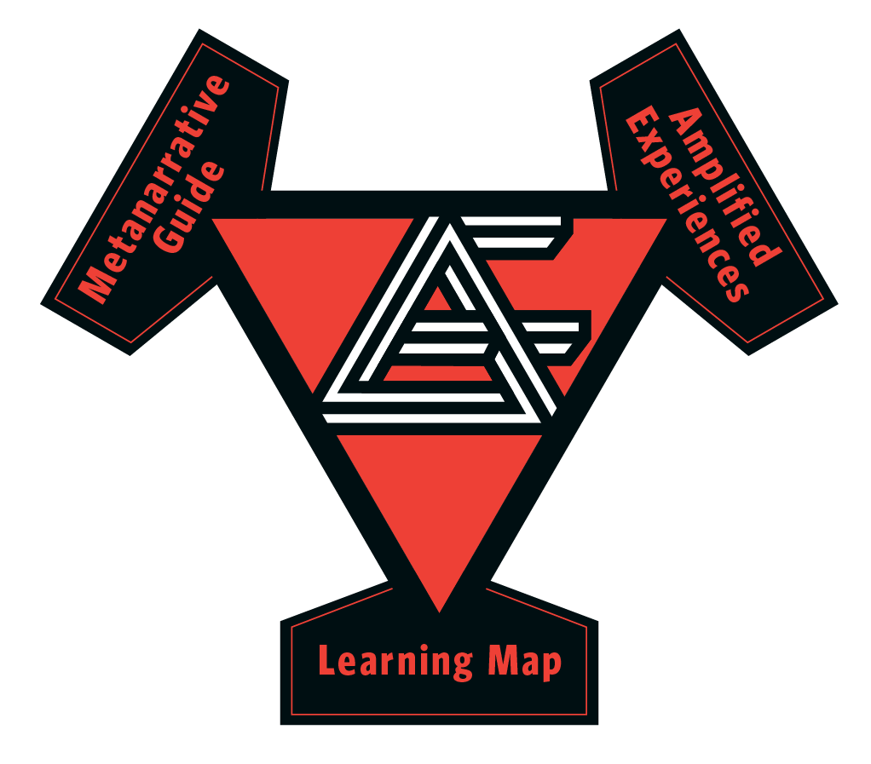

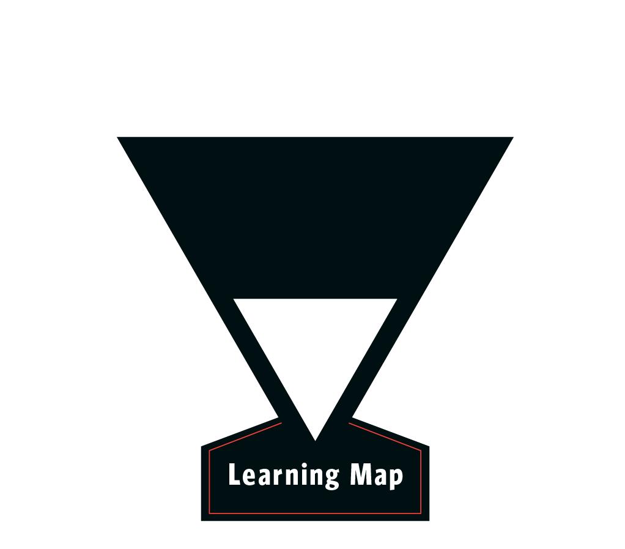
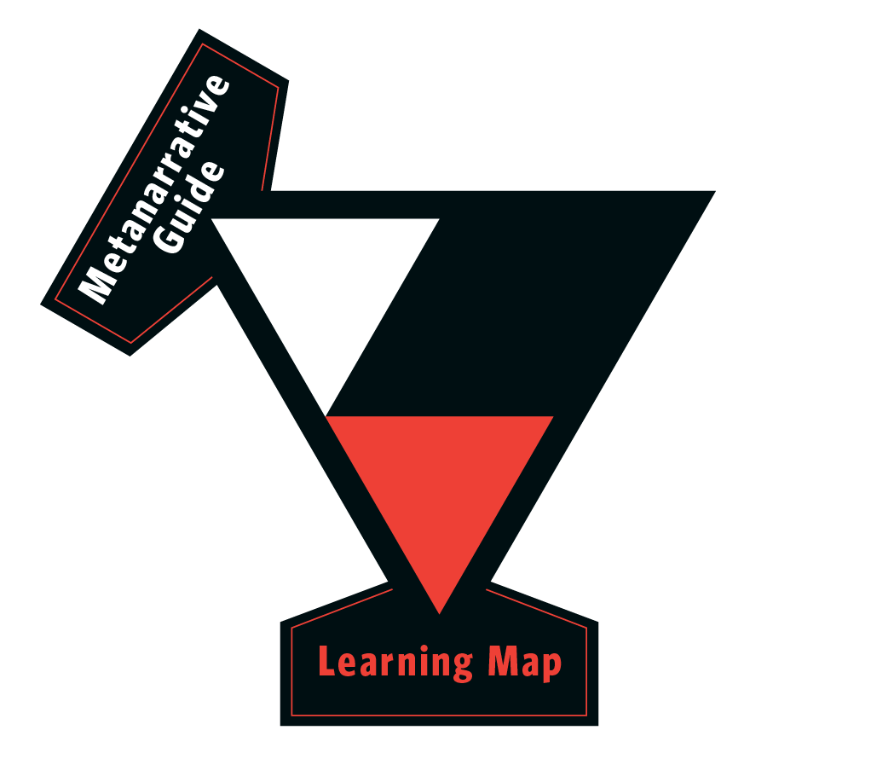
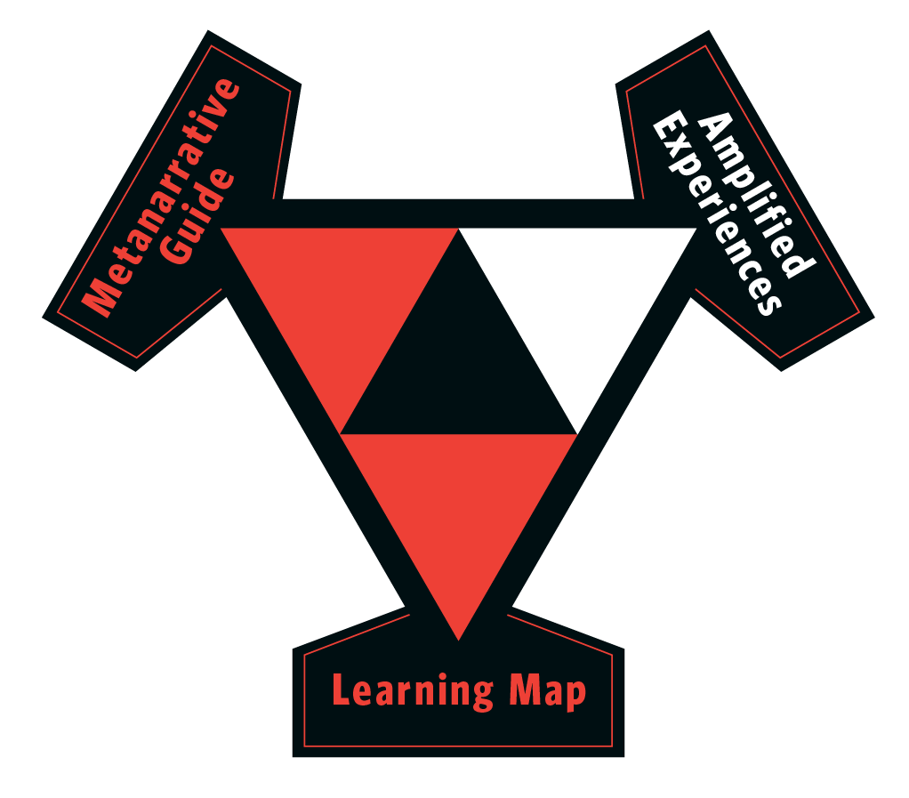
Tools to build learning journeys for our employees that are memorable, engaging and understandable.
How Does this Work?
Notes:
Successful technical and complex training must tell a story that includes both truths and narrative
Real stories augmented with fiction can be more memorable, engaging and understandable
The three tools developed by MetaMythic facilitate creating these applied fictions

Slide 11
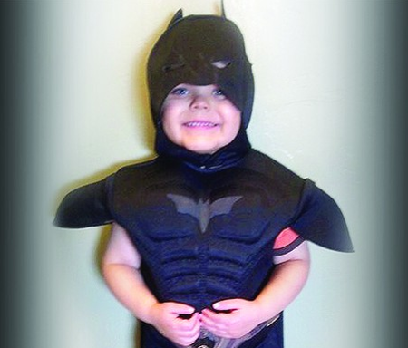
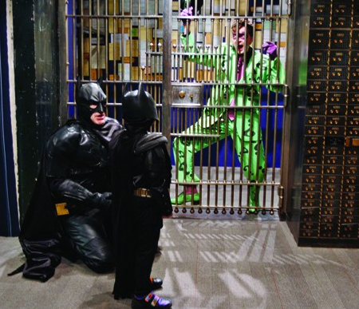
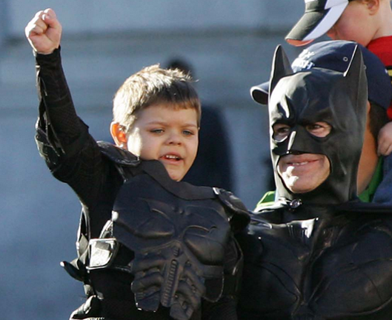
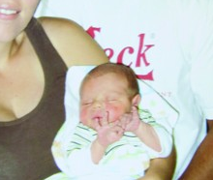
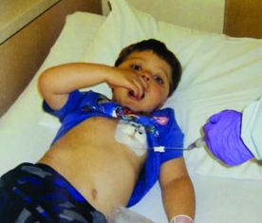
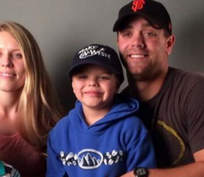
The Hero’s Journey
The Learning Map
A Big Change
Setup
A relatable and
likeable hero
Confrontation
encounters roadblocks
Resolution
and emerges transformed
Notes:
It all starts with what makes a good story. Jake talked about the three part story, so let me go into a bit more detail about this. The three part story has three key elements when the story is about a hero. And this concept of hero is relevant because our stories about about heroes – people in our organization who are out doing the duties of compliance.
Here’s the model
<click>Setup - We're introduced to a relatable and likeable hero <click>. While BatKid was a baby at this stage, we could still like and relate to him.
<click>Confrontation - Who encounters roadblocks <click> But when he goes through the challenges of chemo, we can really start to empathize with the struggle.
<click>Resolution - And emerges transformed <click> and celebrate as he emerges both healthier and stronger as a person
The same applies when we see what the city of SF did for him with their fiction
<click> Batkid is introduced
<click> and struggles against enemies
<click> and emerges transformed
And if you think about it, this model works really well with organizations because our organization heroes are leading our organizations through some Big Changes and need to change themselves.

Slide 12
The Organization’s Journey
The Learning Map
X
Improved
World
The Big Change
The Big Goal
The Big Problem
Ordinary
World
Time
Notes:
So we need to move our organizations from the current ordinary world to the improved world and need heroes to take us there. Just like a hero needs to move from their current world to some improved world where there are transformed. The hero’s journey storytelling model fits perfectly.
The Big Problem is the description of where we are today.
This leads directly to the Big Goal – the place we want to be.
The tools and skills we need people to learn to get to the big goal is the Big Change.

Slide 13
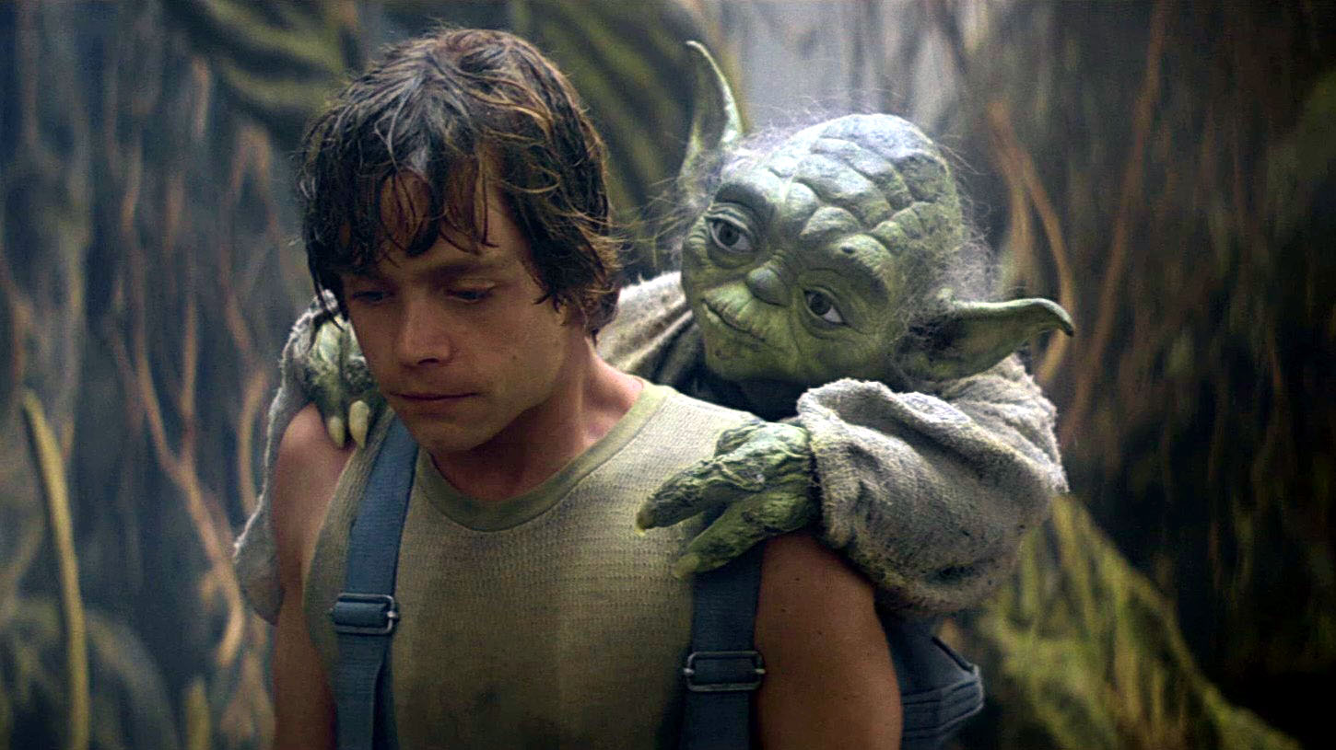
Know Who Your Heroes Are
The Learning Map
Hint: Your Audience
You are not the hero
Notes:
Remember, you are not the hero. The hero in this classic story is Luke – he’s the person doing lightsaber duels and destroying Death Stars. Never forget to have the mindset that your audience is the hero.

Slide 14
The Sage
The Learning Map
“We should [help] people see themselves as the hero of the story … whether beating bad guys or achieving some great business objective.”
- Chad Hodge, Screenwriter
Hint: You
Notes:
So what is your role? You are the Yoda, the Sage. Your job is to call the hero to action and equip them. You have probably been a hero yourself in the past (that gives you credibility), but your role now is to help the heroes.

Slide 15





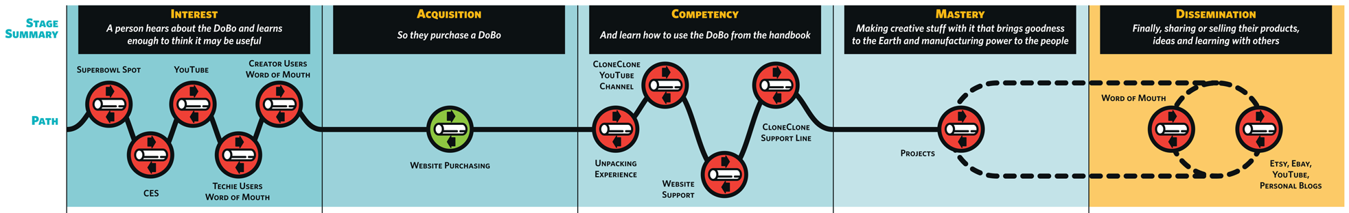
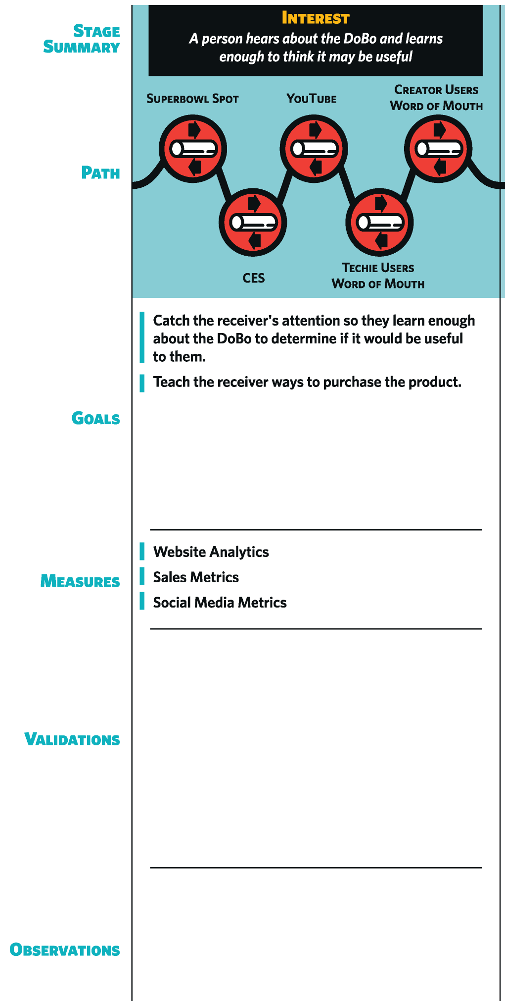
What Does It Look Like?
The Learning Map
Improved
World
X
Ordinary
World
The Big Change
Notes:
We build an organization’s heroes, sages and communications out using a tool we call the Learning Map. We walk through the employee’s (hero’s) journey from onboarding through training and other HP communication points. Each touchpoint in this journey we call a Learning Experience. These experiences are the places where sages and heroes come together and the heroes are equipped for battle by providing them duties, tools and skills.

Slide 16
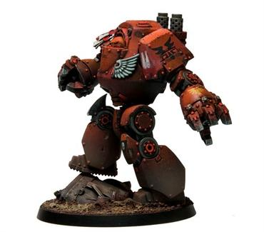
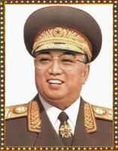
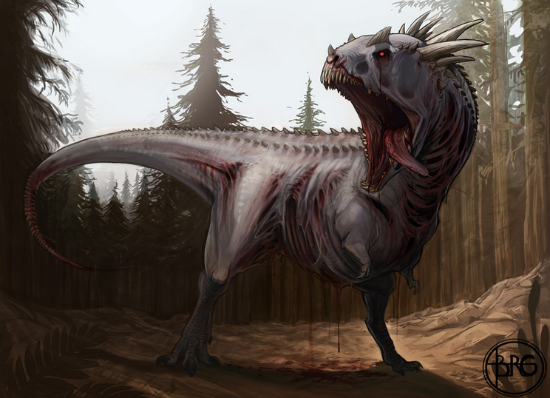
A Consistent Story
The MetaNarrative Guide
Notes:
<higher quality bottom picture>
<space marine - http://spacemarinechaptergame.wikispaces.com/Chapter+Forces+Info>
<dinosaur – TreeDay77 Zombie Dinosaur
-https://www.flickr.com/photos/53346708@N07/4978212621/in/photolist-3hsvoz-f4Fw4v-8hLJCx-67TuTu-67Twd1-67Pi94-67Tvho-9RmeWQ-7bZXPB-7c4Nhm-7bZXXe-6qU4xq-5YAvWw-7FRZLc-4FDBYd-tuC2M-7c4Nku-8zUDb6-9ugvpP-3TxYgx-bvg3R2-4wT5mA-hW9gK-713Zv
-https://creativecommons.org/licenses/by/2.0/>
So where does the fiction come in? Once we know all the Learning Experiences, we can start turning them into scripted experiences with story woven in. That could be in the training materials themselves (like a handbook) or in the event itself (like Brit Beacon). We don’t want to have an inconsistent experience
<click> one event is space marines
<click> another is self-replicating Kims
<click> and another is zombie dinosaurs
So the metanarrative guide defines villains, environments and other thematic elements we want to be consistent across the hero’s journey.

Slide 17
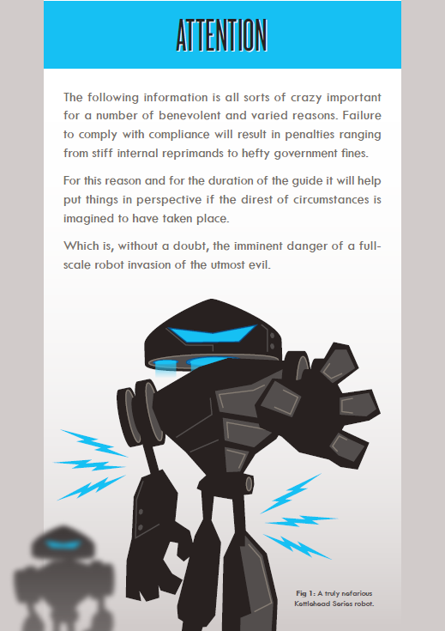
Theme: Case Study
The MetaNarrative Guide
Slightly hard fiction with future Earth a battleground.
Think Terminator with robots from outer space.
Humor inspired by Monty Python.
Notes:
In the Compliance case study, robots from outer space fit well for the metanarrative because the robots can attack both physical and electronic assets. Plus, they don’t require us ton make an enemy of NERC auditors, or even China or Korea, countries that may not always be attacking us. We wanted the enemy to be safe for us to feel them to be the face of evil.

Slide 18

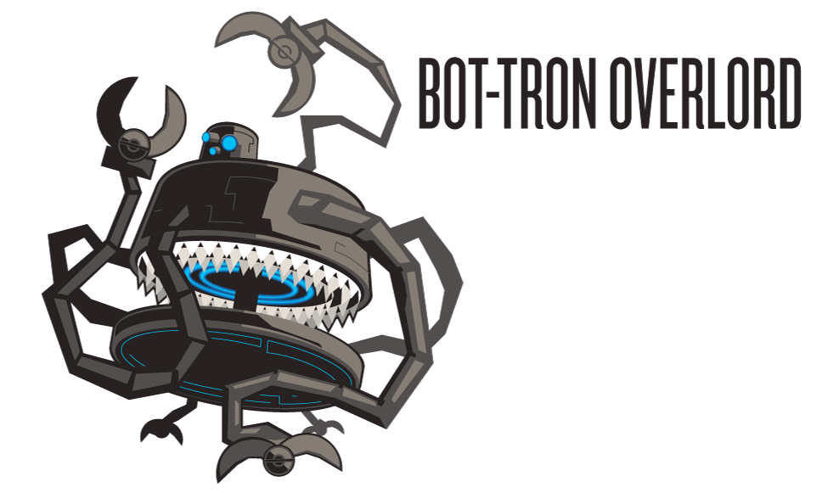


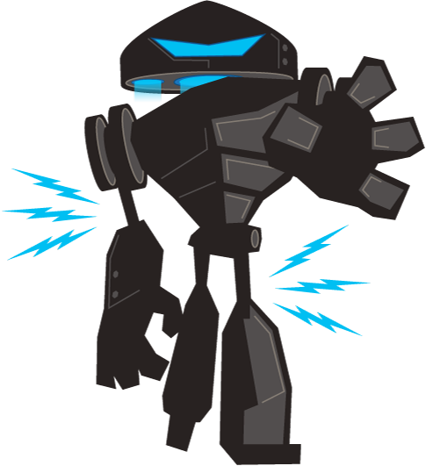








Villain: Case Study
The MetaNarrative Guide
[Top Secret]
“cyber assets
…nom nom nom”
“whirl, clank, crunch, grind”
“as you know, Jim…”
“I’ll show you my source code if you show me yours…”
Notes:
So we build a robot army that each had specialties for attacking our infrastructure. With a enemy leader, Nemitrus.

Slide 19






Conflict
The MetaNarrative Guide
“Again we see there is nothing you can possess which I cannot take away.”
- Belloq
“That belongs in a museum.”
- Indiana Jones
Motivation
Subject
Resolution
Notes:
The metanarrative conflict is also important. It must be consistent through the experiences and have the same resolution. Just like Indiana Jones always resolved the conflict over ancient artifacts of power by saying “that belongs in a …”
<wait for audience>
Museum, right. Our own fictions need to have conflicts that resolve in the same way the real world conflict is resolved. So, as an example:

Slide 20


Conflict: Case Study
The MetaNarrative Guide
Notes:
How do we defeat robots? The same way we defeat the enemies in the real world – through knowing and applying your duties – patching computers, being careful who you talk to, escorting visitors properly.

Slide 21




The Director’s Chair
Amplified Experiences
Notes:
Finally, once we have the learning map and metanarrative guide, we can script out the individual experiences. These can be large like what we did for the event - here you can see some of our script with each scene broken out. It’s a lot like writing a movie script. Sometimes experiences are much simpler. <click> Here is another example of an email that went out after our case study company built their backup control center. Brit Beacon thanked the company for building the backup control center because HQ is a crater in the distant future because the robots bombed the building and the company is operating from the BUCC now.

Slide 22
Tools to build learning journeys for our employees that are memorable, engaging and understandable.
The Three Tools
Notes:
Successful technical and complex training must tell a story that includes both truths and narrative
Real stories augmented with fiction can be more memorable, engaging and understandable
The three tools developed by MetaMythic facilitate creating these applied fictions

Slide 23











Since We Last Met…
CIPv3 Compliance
Advertising Industry ESOP
EMS Employee Training
Applied Fiction Training
CIPv5 Compliance x2
Notes:
So what else are we working on?
We talked about the CIP v3 compliance
We also did one in the advertising industry based on evil spirits (creative people dig the dark and mysterious)
We worked with a company to create a employee training system based on the Lord of the Rings
We also worked with UX Week to create applied fiction training
Finally, we are working with two companies on a CIPv5 training program

Slide 24
Studio
Building tailored experiences
PRODUCT
Providing turnkey solutions
TRAINING
Sharing the love
Notes:
At MetaMythic we believe the pen is mightier with the sword and our organizational purpose is to get applied fiction out to the world. We have three areas of service we’re developing:
Studio is where we build tailored experiences. This is our main focus right now and what we showed in this presentation.
Product is where we build solutions that we can quickly provide companies who may not have the budget or are more risk averse to the bigger events. We don’t have any of these yet, but are exploring this space.
Training is where we can teach you how to make your own applied fiction.

Slide 25

Helping your people become the heroes
of your organization’s story
www.metamythic.co
Notes:
Stories are good as tools, and we are players in our organization’s stories
Start thinking about ourselves as sages and our people as heroes
Let us know what you think and if we can help in any way. We’d love to hear from you.

